Slide 1

Enhancing Search Engine For Video Subtitles

Slide 2
About me
I am Sai Sujitha.
M.Sc. Biotechnology
As Data science is used in many Industries even in my stream of education so I choose data science.
LinkedIn - https://www.linkedin.com/in/sujitha-iragavarapu-840a9a78/
Github - https://github.com/Suji1612
Medium - https://medium.com/@sujisree9

Slide 3
Objective Of The Project:
Develop an advanced search engine algorithm that efficiently retrieves subtitles based on user queries, with a specific emphasis on subtitle content. The primary goal is to leverage natural language processing and machine learning techniques to enhance the relevance and accuracy of search results.

Slide 4
Types of Search Engines
Keyword Based Search Engine: These search engines rely heavily on exact keyword matches between the user query and the indexed documents.
Semantic Search Engines: Semantic search engines go beyond simple keyword matching to understand the meaning and context of user queries and documents.

Slide 5
Steps Involved

Slide 6
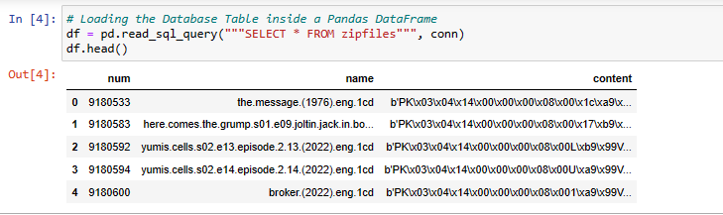
Part 1: Ingesting the documents
1.Data Collection:
Download Data and convert from .db file into pandas DataFrame
Pick 30% data to work with.

Slide 7
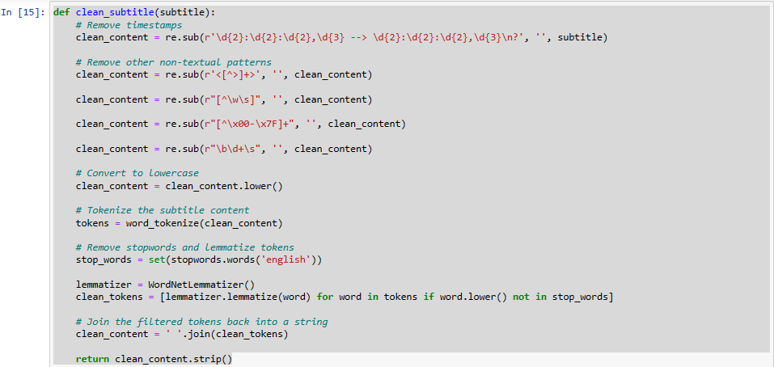
2. Preprocessing the Data:
Remove timestamps
Eliminates stop words , punctuations
Convert all text into lower case
Getty Images

Slide 8
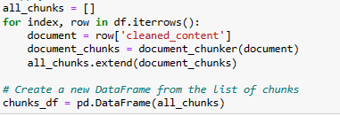
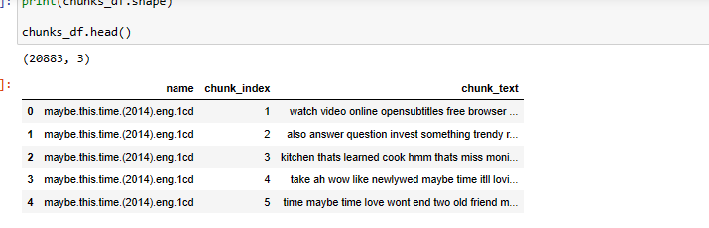
3.Document Chunker
Consider the challenge of embedding large documents: Information Loss.
It is often not practical to embed an entire document as a single vector, particularly when dealing with long documents.
Solution: Divide a large document into smaller, more manageable chunks for embedding.
Another Problem: Let’s say we set the token window to be 500, then we’d expect each chunk to be just below 500 tokens. One common concern of this method is that we might accidentally cut off some important text between chunks, splitting up the context. To mitigate this, we can set overlapping windows with a specified amount of tokens to overlap so we have tokens shared between chunks.

Slide 9
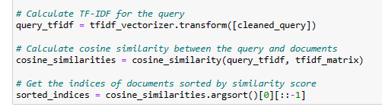
4.Vectorization:
BOW / TFIDF to generate sparse vector representations. Note that this will only help you to build a Keyword Based Search Engine.
BERT based “Sentence Transformers” to generate embedding's which encode semantic information. This can help us build a Semantic Search Engine.

Slide 10
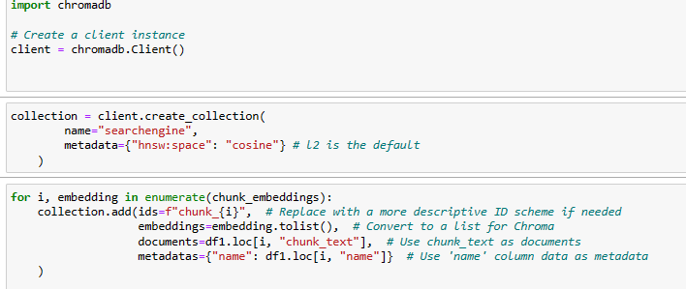
5.Storing Embedding's:

Slide 11
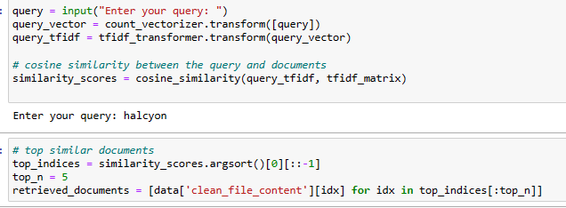
Part 2: Retrieving Documents
Take the user's search query.
Preprocess the query (if required).
Create query embedding.
Using cosine distance, calculate the similarity score between embedding's of documents and user search query embedding.
These cosine similarity scores will help in returning the most relevant candidate documents as per user’s search query.

Slide 12
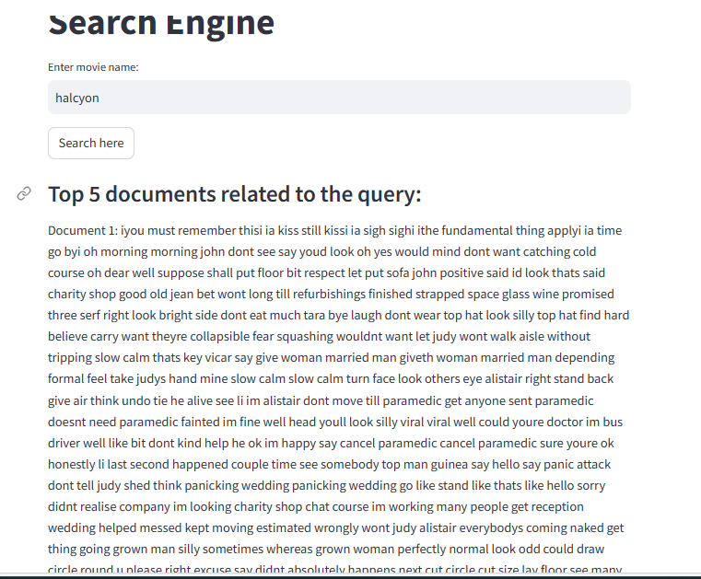

Results:

Slide 13

THANK YOU

